Slide 1
Hack Foster Care
TILP / AB12
Claire, Will, Dylan, Divya

Slide 2
Problem
What are we trying to solve: The current TILP completion process is not informative nor easy accessible for foster youth
No clear definition of “what is a goal”
Not a living, trackable document
Little to no accountability
Little to no positive reinforcement to complete and start new goals

Slide 3
Solution
Start from the beginning to empower youth: An online goal introduction and management platform
Youth centered design (target end user)
Automatic workflow routing to increase accountability
Feedback and recognition
Exportable

Slide 4
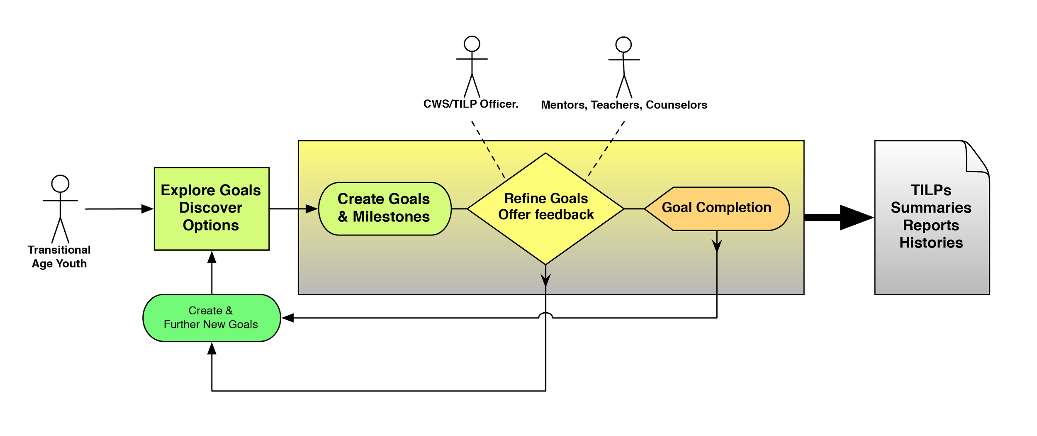
The Roadmap

Slide 5
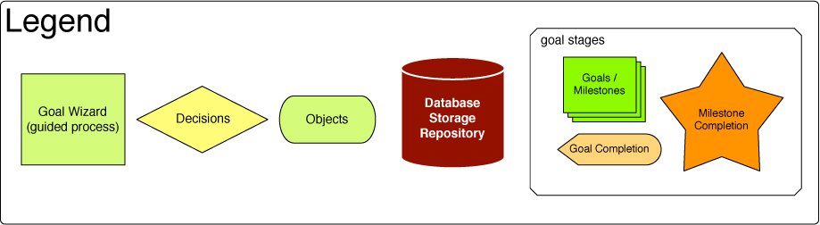
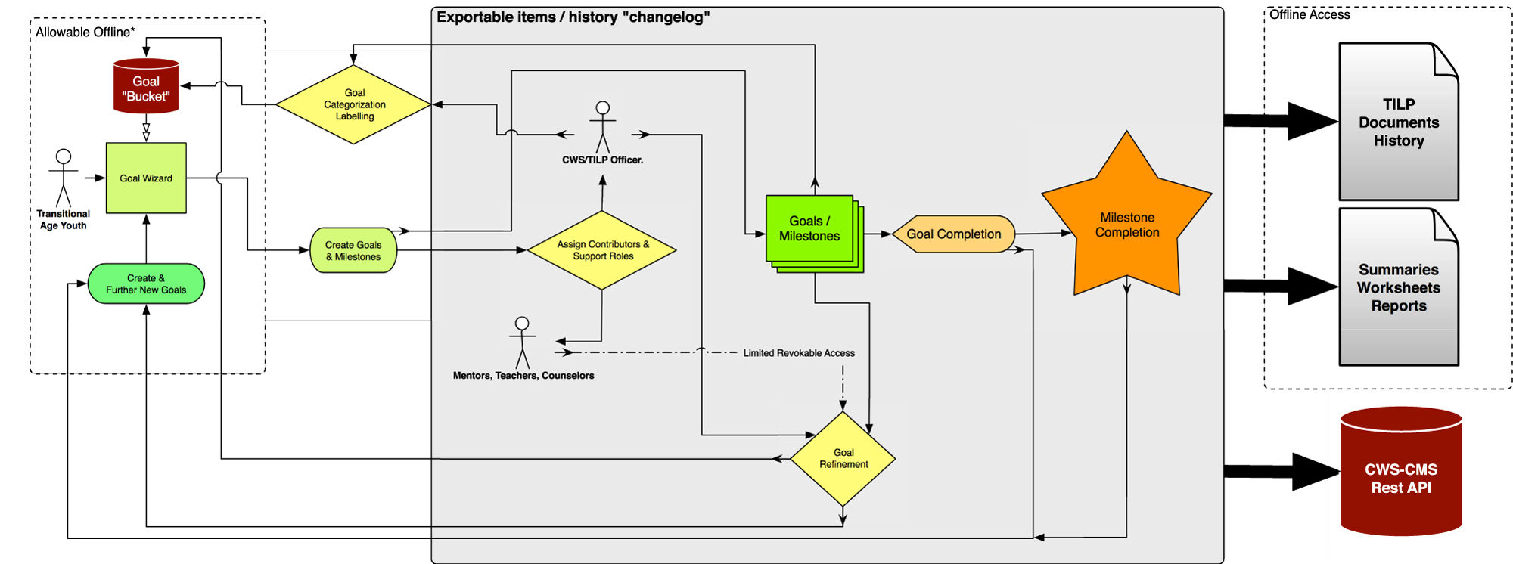
“Basic” Blueprint

Slide 6
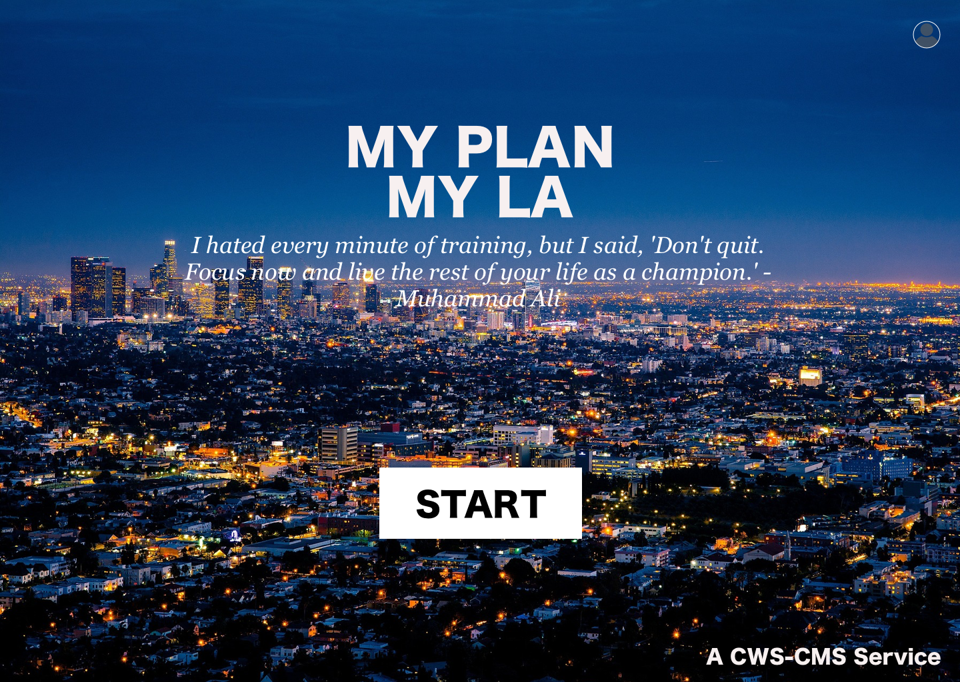

Slide 7
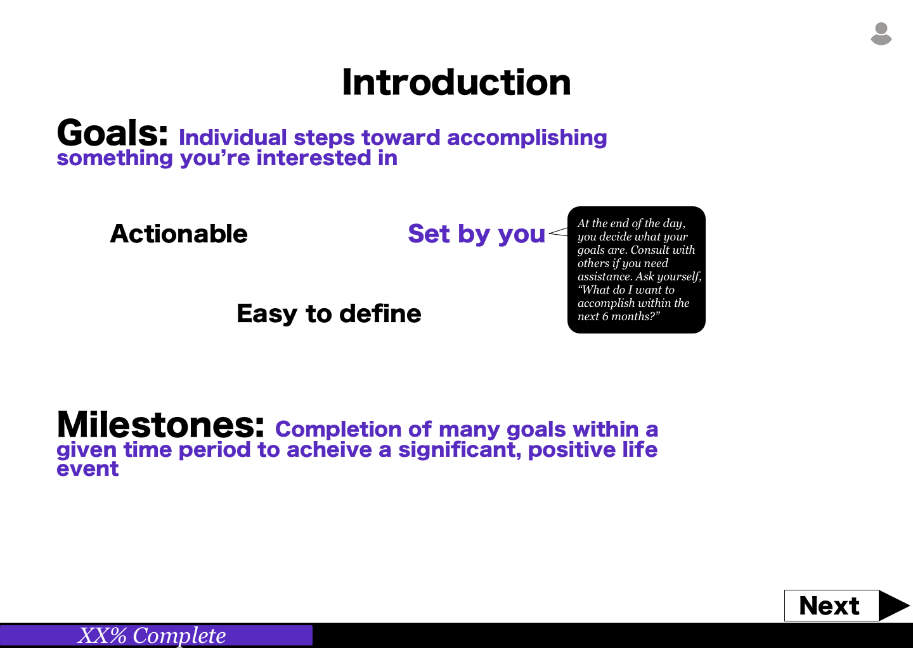

Slide 8
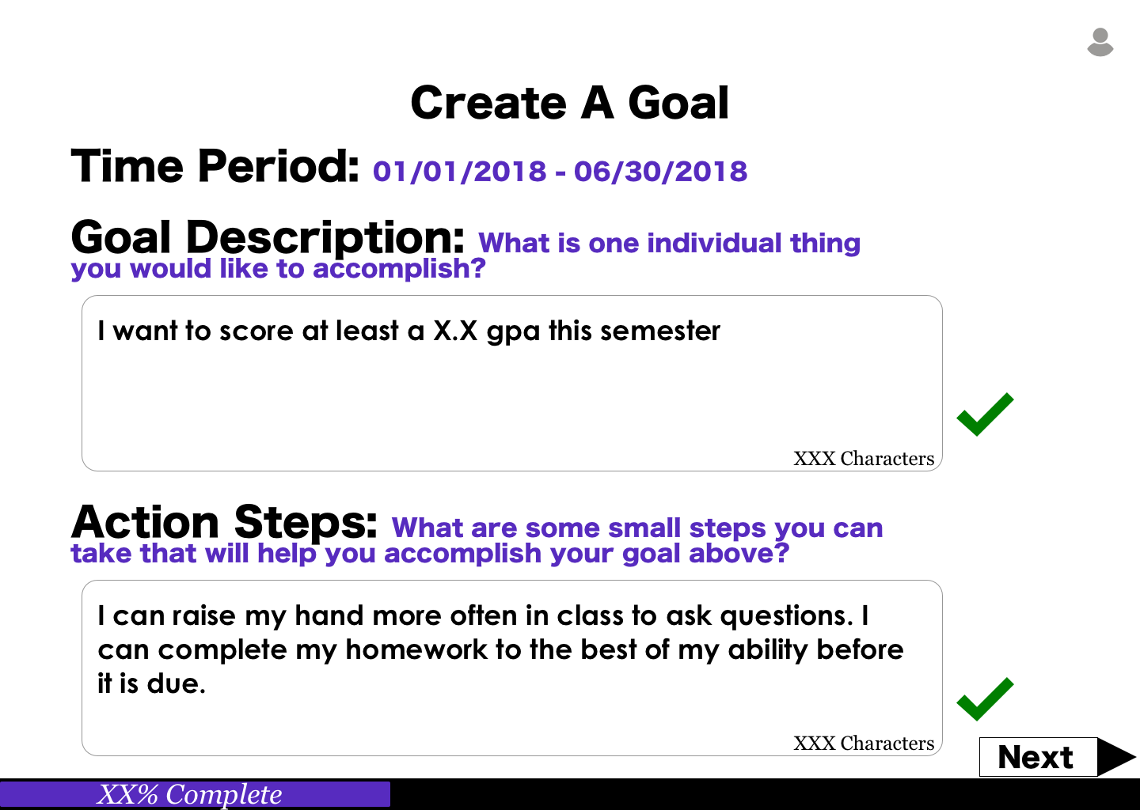

Slide 9
Goal/Milestone Workflow
By creating a system with well defined workflow steps to facilitate goal setting and tracking, we believe Youth will receive the following benefits:
Improved feedback loop and increased level of support
Increased accountability on all parties
Increased empowerment of Youth to set and accomplish Goals/Milestones
Increased engagement in Goal/Milestone setting and follow-through
Youth Creates Goal/Milestone (“G/M”)
G/M auto-assigned to the Caseworker
G/M can be assigned back to Youth if incomplete
Caseworker Reviews G/M
Feedback to be provided and label to be added for easy tracking (ex. “Education,” etc)
Youth marks G/M complete
Caseworker Reviews Youth Completed G/M
Completion criteria should be measured, and feedback provided if deemed to be incomplete
(Default) G/M auto-assigned to Youth
Youth Reviews Feedback and Owns Next G/M Action
(Optional) Caseworker can assign G/M to other member in care team for additional review
Youth can assign G/M to any care team member for anything blocking progress or if general help is needed
(Default) G/M auto-assigned to Youth
Youth will be prompted to set new Goals/Milestones to spur continued action/progress
Care Team Member Reviews G/M
Feedback to be provided
Care Team Member Reviews G/M
Action should be taken or feedback provided depending on the ask from the Youth
Goal/Milestone Achieved!
(Optional) Caseworker can assign G/M to other member in care team for additional review
(Optional) Caseworker can assign G/M to other member in care team for additional review

Slide 10
Increased Accessibility of Goal Setting/Tracking Tools for Youth and TILP Document Exports for Caseworkers
By allowing Youth and the care team to print working documents (level of access to this service will be based on permissions), we can enable the means for continuous development of goals and milestones.
Documents must be made more accessible (via a print view or offline mode) to Youth for continuous development of Goals/Milestones:
Goal/Milestone Setting View - for new goal/milestone setting
Existing Goal/Milestone View - for tracking existing goals/milestones
Note - this will break out goals/milestones based on status, and current assignee to allow for easy tracking
Completed Goal/Milestone View - for tracking and celebrating achievements
TILP document export must be automated and improved for Caseworkers:
Caseworkers should be able to export a TILP document at any point in time, which must capture all Completed and In Progress Goals/Milestones

Slide 11
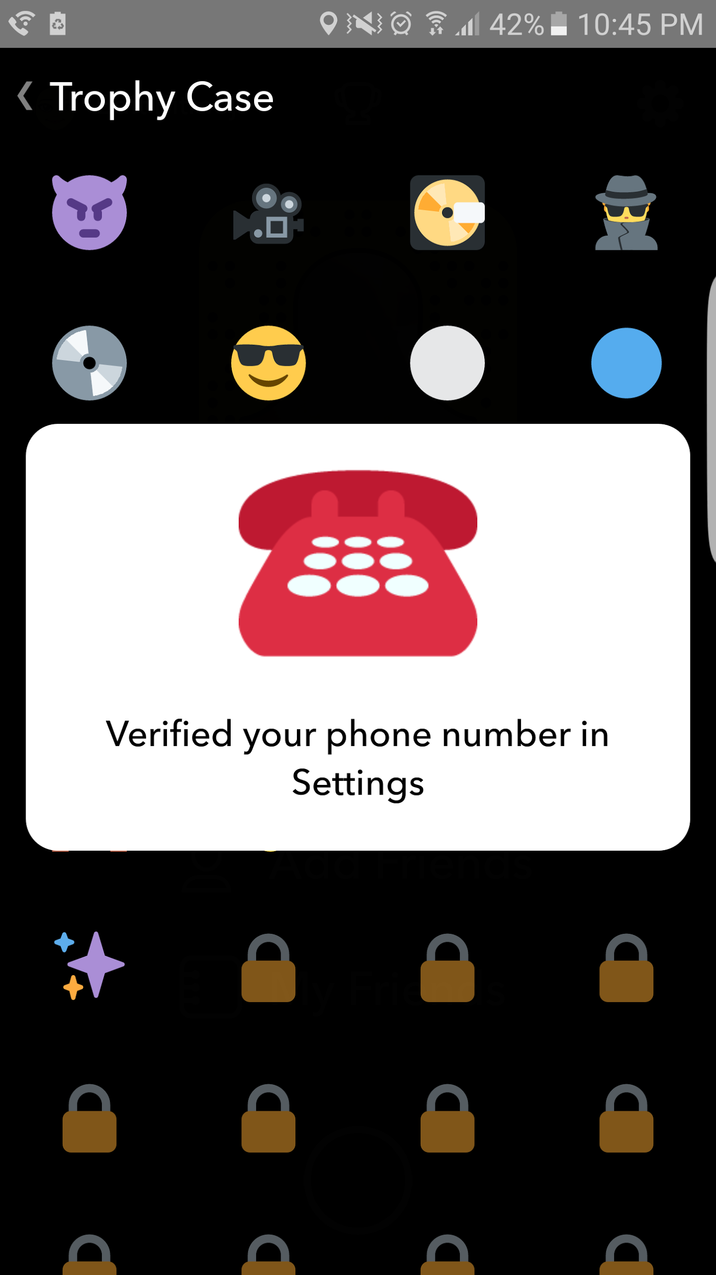


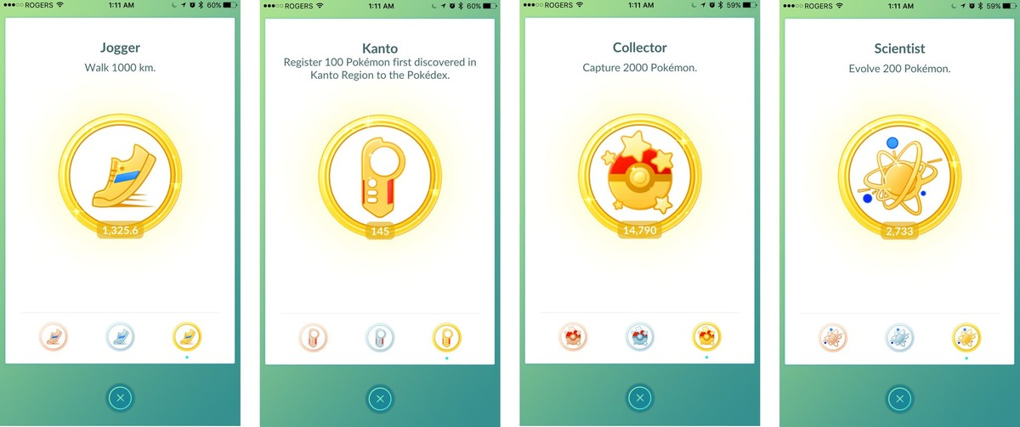
Trophies...
Are exciting
Raise self esteem
Motivate youth to achieve goals
Increased account security
Guide others
Addictive, encourage achieving more
Notes:
Trophies
- Are exciting
- Raise self esteem
- Motivate youth to achieve goals
Snapchat has a trophy for verifying phone number ----> Increased account security
Pokemon is addictive ---> you want to play more to catch variety of pokemon
Other youth reach out to you for guidance

Slide 12




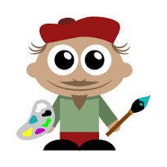
Set New Goals

Slide 13
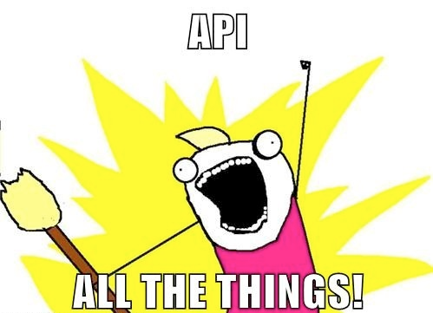

Improvement Strategy “Where must we go from here?”
APIs(Application Programming Interface) “When computers talk and ask each other for information”
Refactor existing systems / CMSs to securely transfer information
Data reliability
Speed / Efficiency (Automation)
“Paperless” until needed
Automated feedback / response
Improved Analytics / Informed Decision Making
Increased knowledge base for increased holistic understanding...
Identify patterns, and find problems before they become unmanageable…
CWS as Microservices???
Agile (Single Responsibility Principle),
Modular (easy to enhance, refactor),
Flexible (choose any combination of platforms),
Highly Scalable / Expandable,
Resilient (error and tech changes)
= Low-Risk High Reward
Notes:
Anecdote? Example of identifying a problem before it's unmanageable. Imagine a scenario where someone comes to you before a problem has become a real problem.

